Slide 1
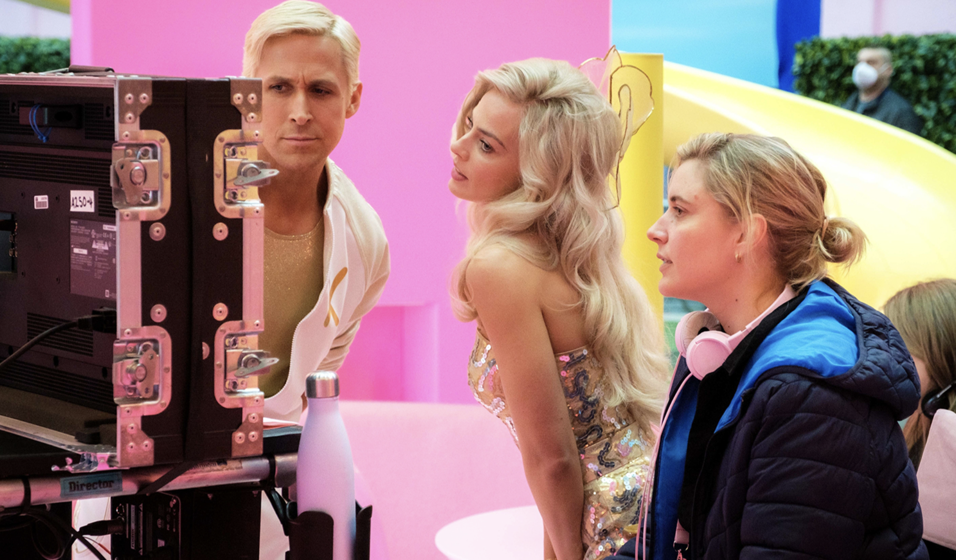
Behind the Camera-
exposing gender gaps in film direction

Slide 2
Behind the Camera
The Role of Gender in Movie Directing
Marlene Bauer
Sarah Müller
Lilo Walter

Slide 3
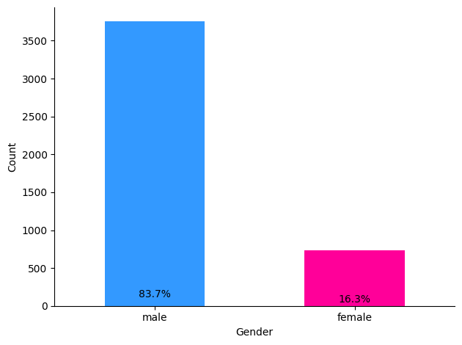
Is there gender inequality on Netflix?
YES

Slide 4
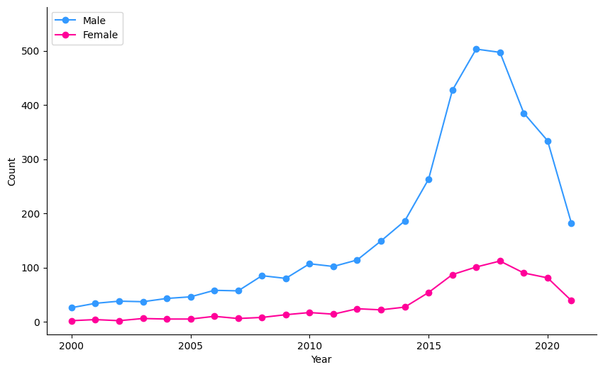
Gender Inequality over Time

Slide 5
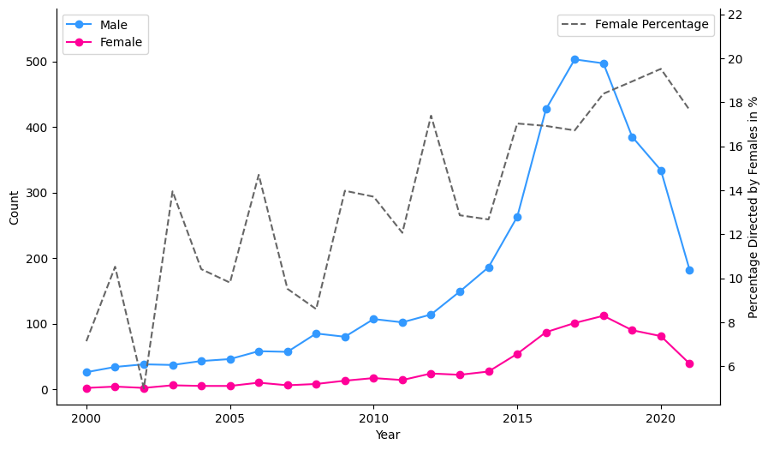
Gender Inequality over Time

Slide 6
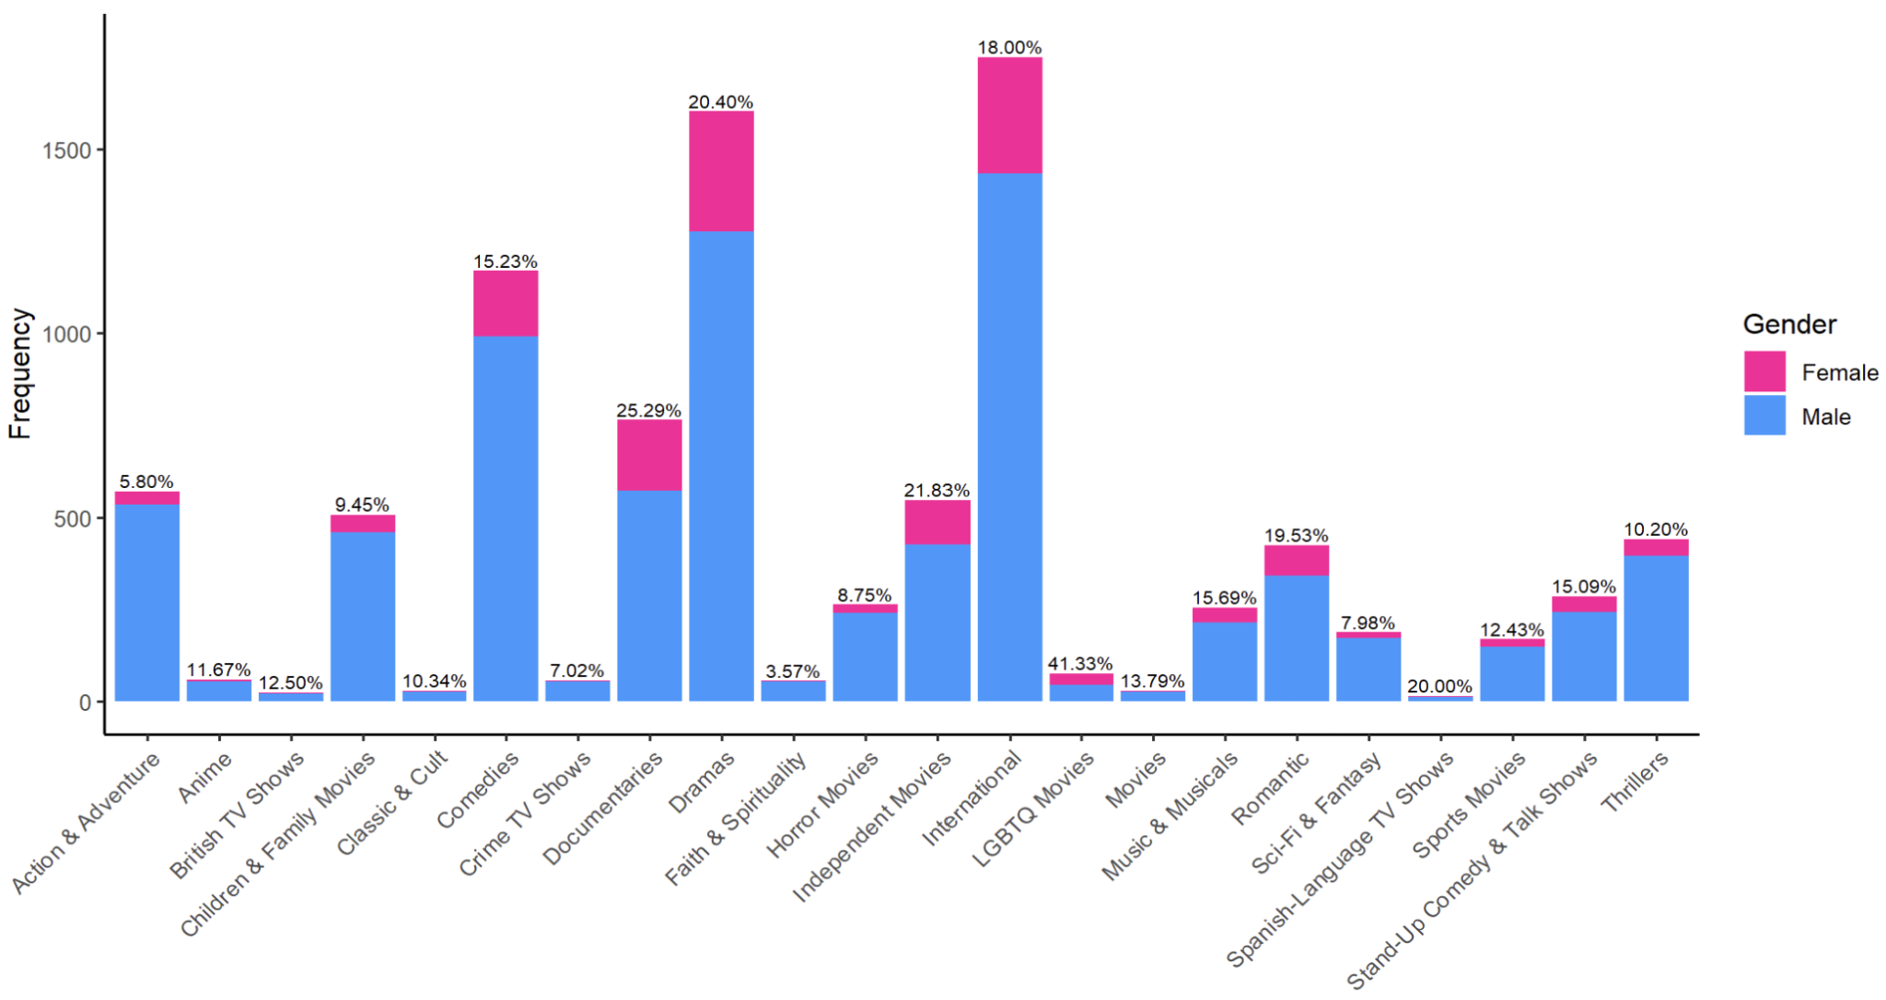
Differences in Directors Gender by Genre

Slide 7
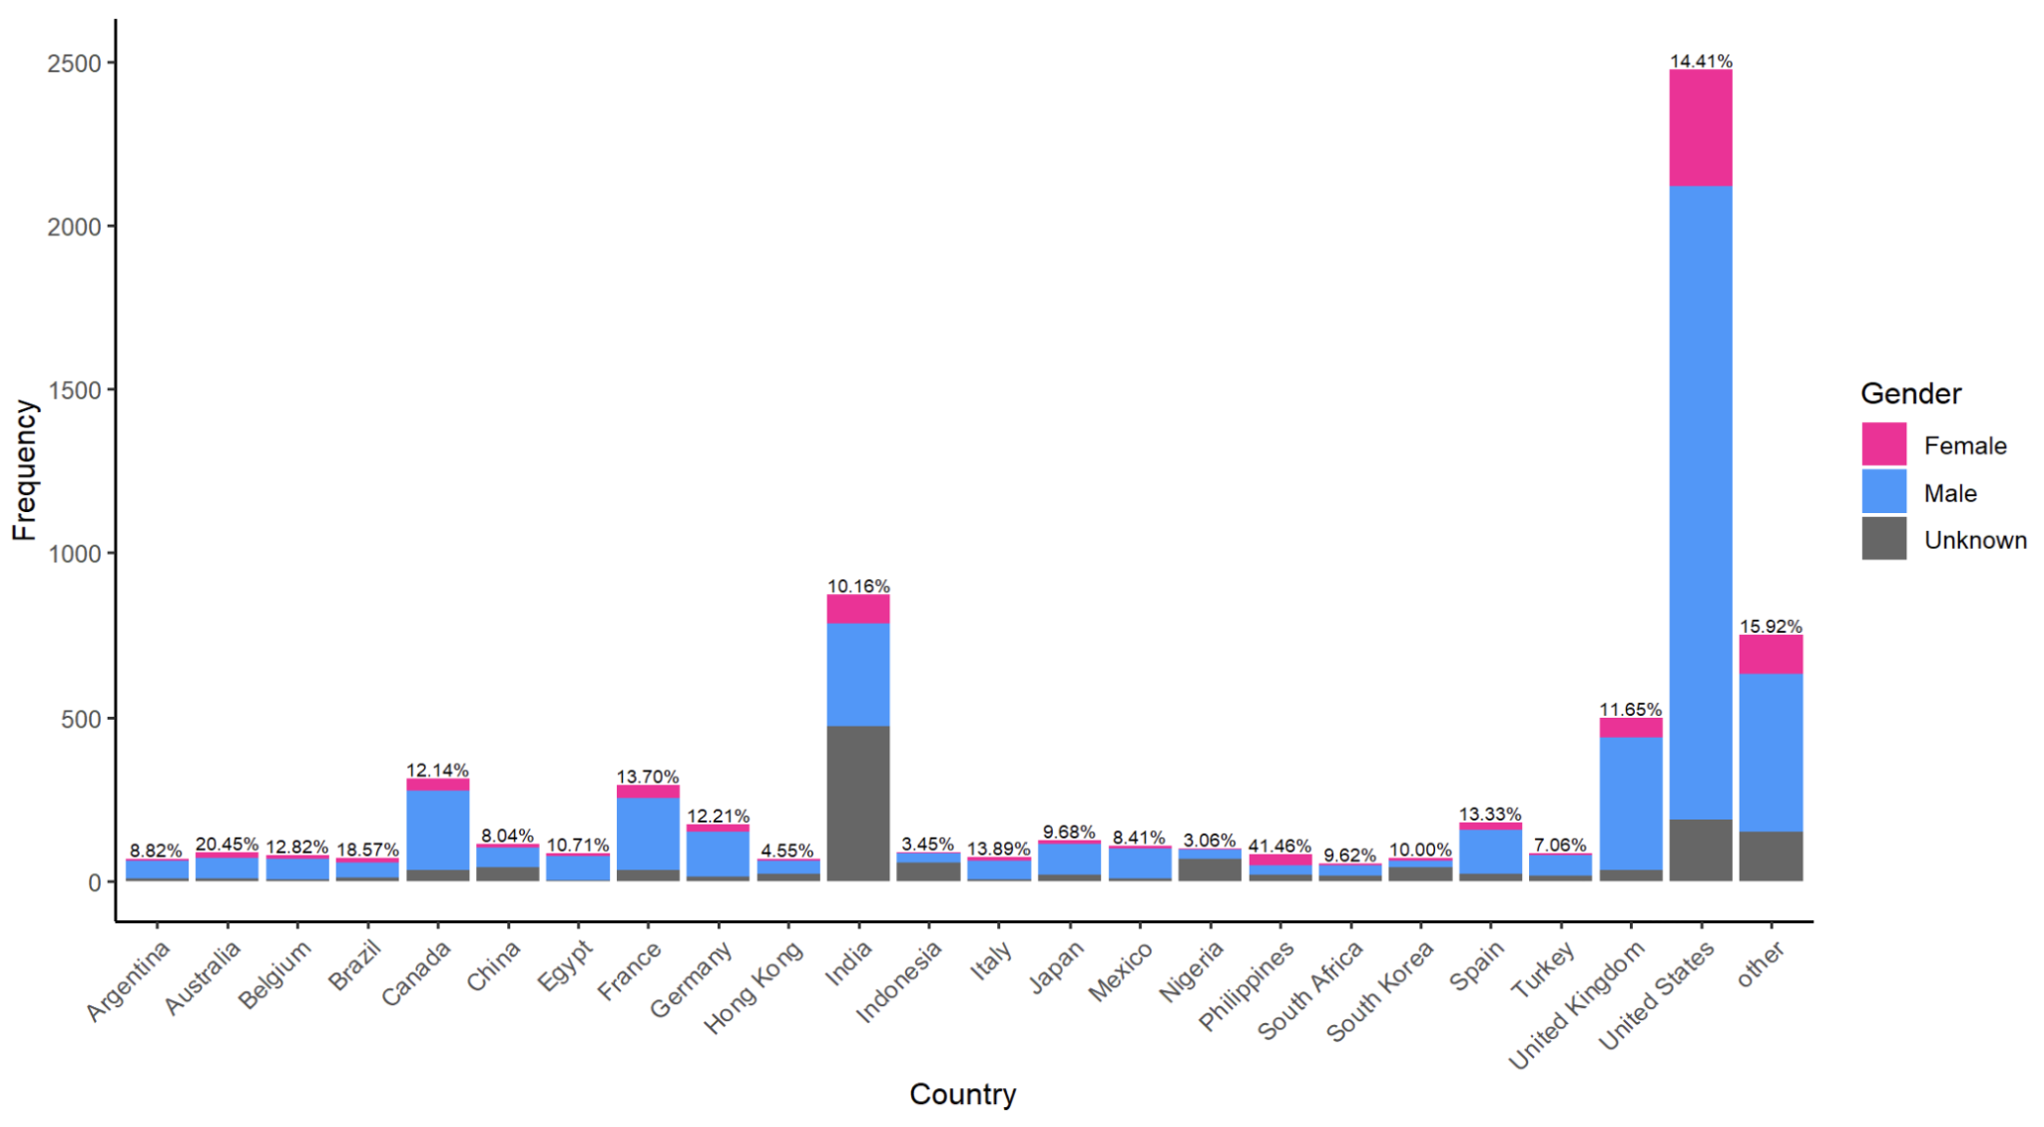
Differences in Directors Gender by Countries

Slide 8
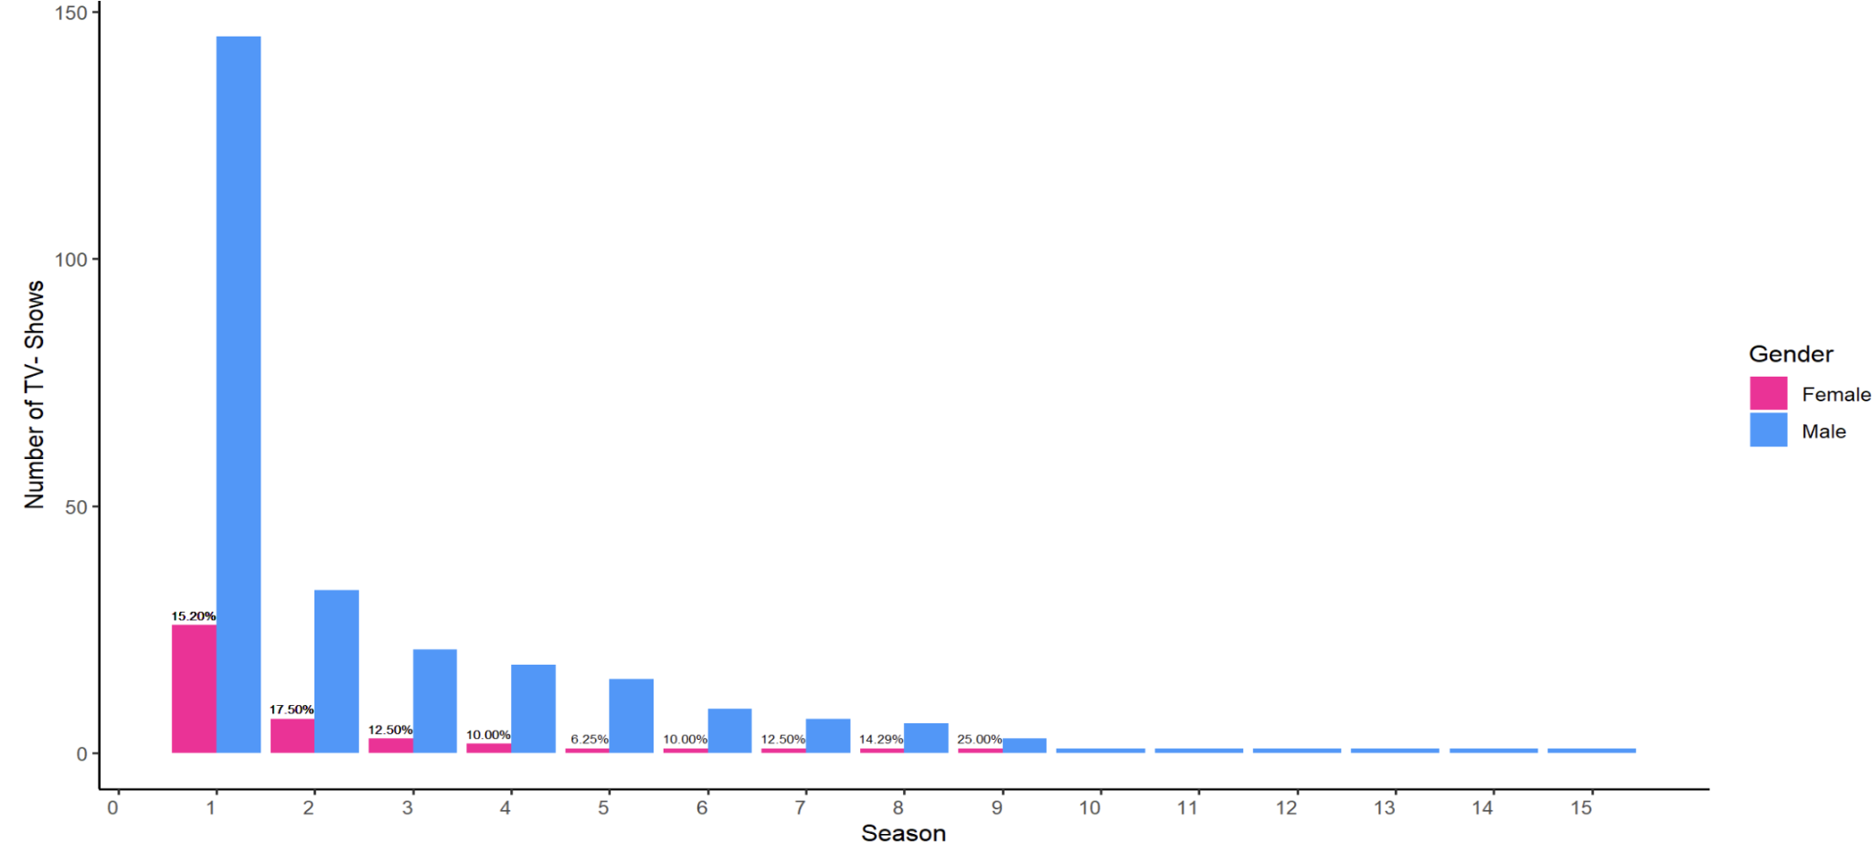
Season of TV Shows by Directors Gender
Notes:
Call the Midwife

Slide 9

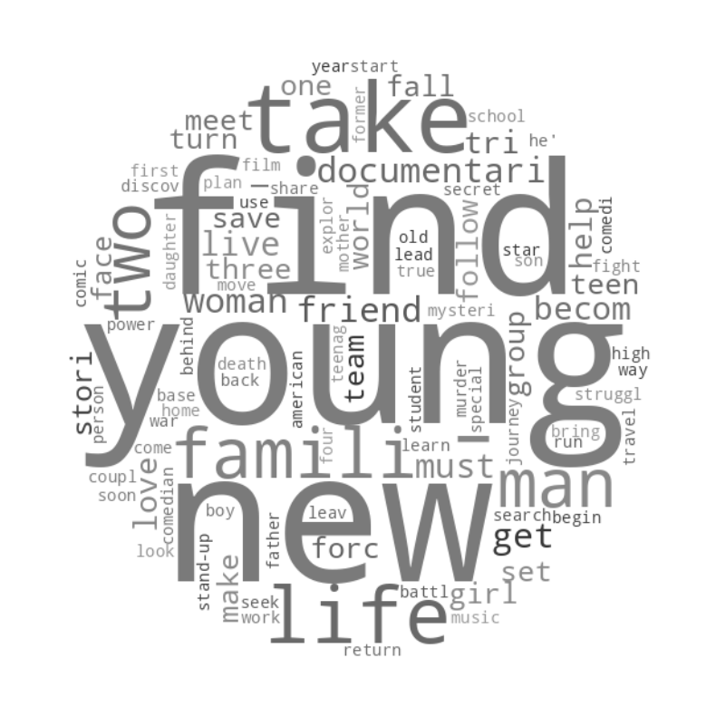
Most common words in movie descriptions…

Slide 10



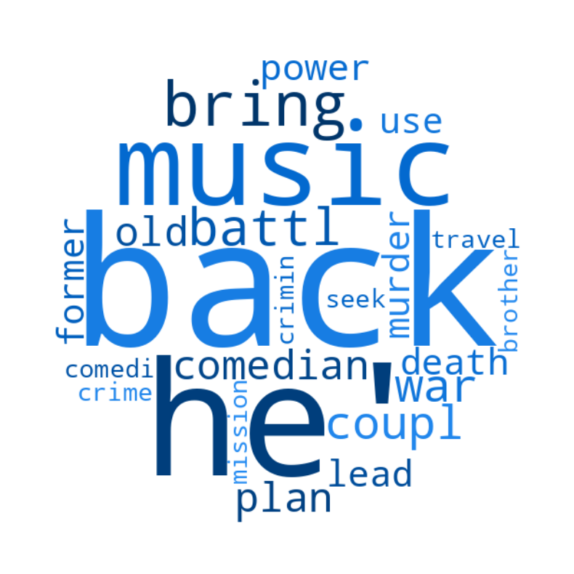
… by gender

Slide 11
Thanks for your attention

